Slide 1
The Art of Research
Raleigh Maxwell

Slide 2
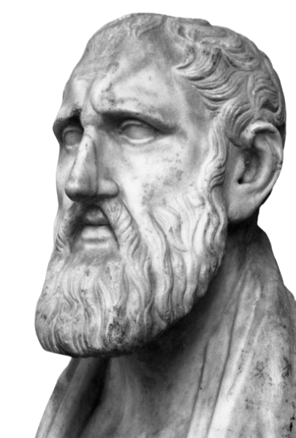
“Progress is not achieved by luck or accident but by working on yourself daily.”
Epictetus, 50 AD-135 AD

Slide 3
Why do we research?
Competitive Incentives | Our goal is to out research our opponents. Why? Research… 1. Substantiates claims 2. Guides argument strategy 3. Acts as a “third partner” with extra speaking time
Educational Incentives | Attaining a deep understanding of the topic necessitates research
Extradebate Benefits | Being able to research effectively ports over to school, jobs, etc.
Joy | Research is fun!

Slide 4
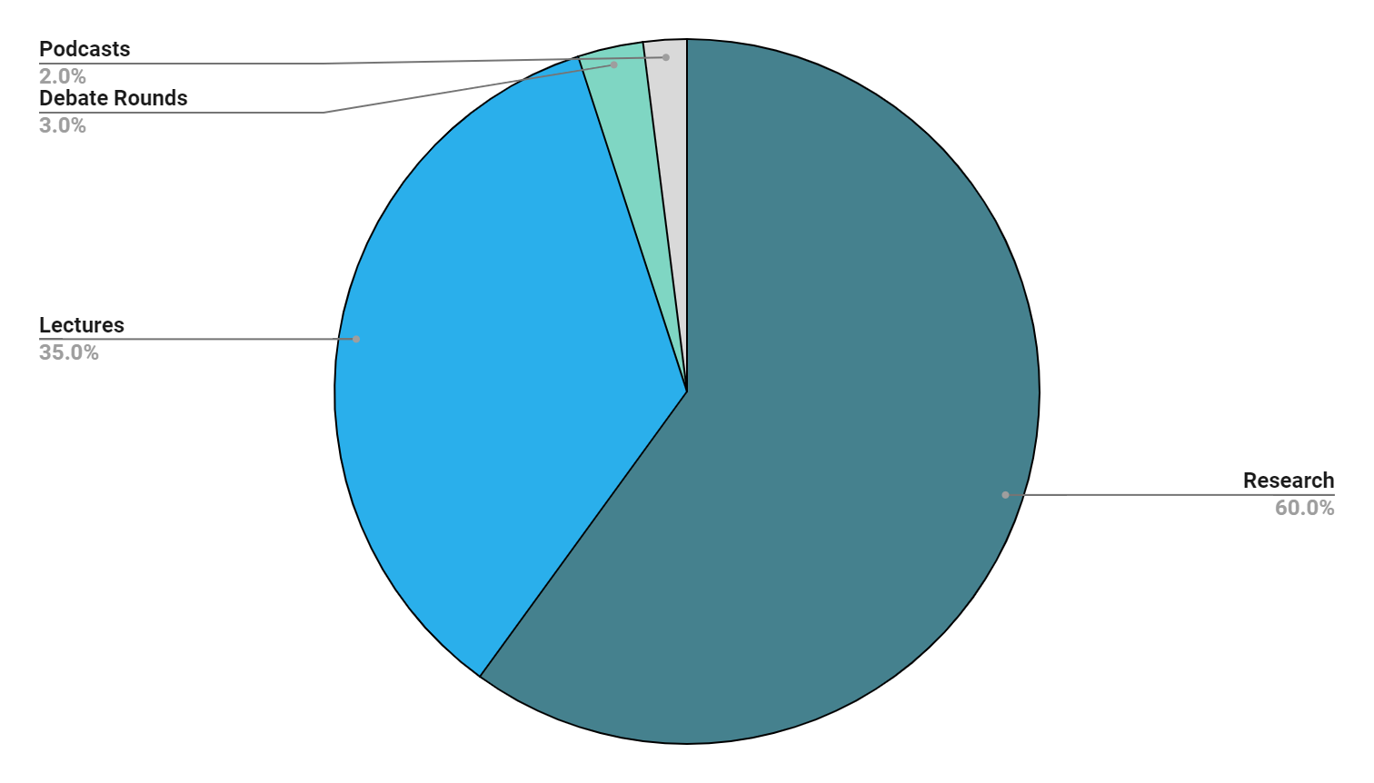
Topic Knowledge
60%
35%
3%
2%
Research (increases t/o season)
Lectures
Debate Rounds
Podcasts (check out Policy Debate Central!)

Slide 5
How do I improve?
Work is habit
Research isn’t easy. Mastering the art of research requires a great deal of dedication to refining and learning on a daily basis, just as Epictetus said.

Slide 6
How do I improve?
Work is habit
Goal is efficiency
Research isn’t easy. Mastering the art of research requires a great deal of dedication to refining and learning on a daily basis, just as Epictetus said.
Don’t solely focus on quantity, or even quality, of cards. Prioritize efficiency. Habitualizing your research practices will make you a very capable researcher.

Slide 7
How do I improve?
Work is habit
Goal is efficiency
Research isn’t easy. Mastering the art of research requires a great deal of dedication to refining and learning on a daily basis, just as Epictetus said.
Don’t solely focus on quantity, or even quality, of cards. Prioritize efficiency. Habitualizing your research practices will make you a very capable researcher.
Maintain patience
Improving your research skills takes a lot of time. Don’t expect immediate results, but realize that every second you invest in improving your research skillls translates into saving you a ton of time.

Slide 8
How do I improve?
Work is habit
Goal is efficiency
Research isn’t easy. Mastering the art of research requires a great deal of dedication to refining and learning on a daily basis, just as Epictetus said.
Don’t solely focus on quantity, or even quality, of cards. Prioritize efficiency. Habitualizing your research practices will make you a very capable researcher.
Maintain patience
Ask for help!
Improving your research skills takes a lot of time. Don’t expect immediate results, but realize that every second you invest in improving your research skillls translates into saving you a ton of time.
I learned all of this from coaches, lab leaders, and teammates and am still learning more from these people. Never be afraid to ask for help.

Slide 9
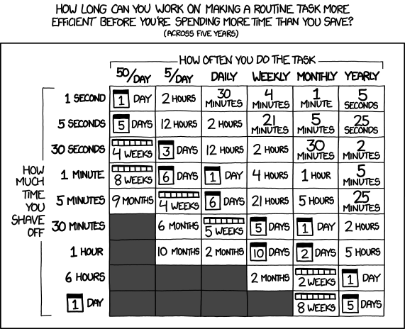
Why invest in the little things?
Source: xkcd, credits to Truf for finding this graphic!

Slide 10
Research Roadblocks + How to Prevail
Burnout
CCADD (Card Cutting Attention Deficit Disorder)
Symptoms:
Physical exhaustion
Cynicism
Anger
Cures:
Ask for help
Try a new angle/assignment
Close your computer
Symptoms:
Endlessly going down research rabbit holes
Never finishing a file
Cures:
Organization
Save those rabbit holes for later

Slide 11
Phases of File Production
01
02
03
Research
Processing Cards
Organizing Files

Slide 12
01
Research

Slide 13
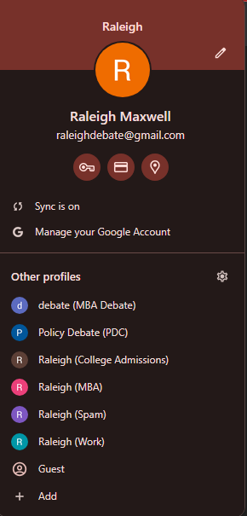
Use Google Profiles!
Click here!
Before you do any research, separate your non-debate Google use from your debate use
Using separate Google profiles makes research so so much easier. I would strongly recommend creating a debate email, so you can have an inbox dedicated to debate-related newsletters, google groups, etc. All debate-related chrome extensions will also stay on your debate profile. You can pin debate tabs, etc.

Slide 14
Type 1: Passive Research
Why do we use passive research?
How do I passively research?
Google Alerts

Slide 15
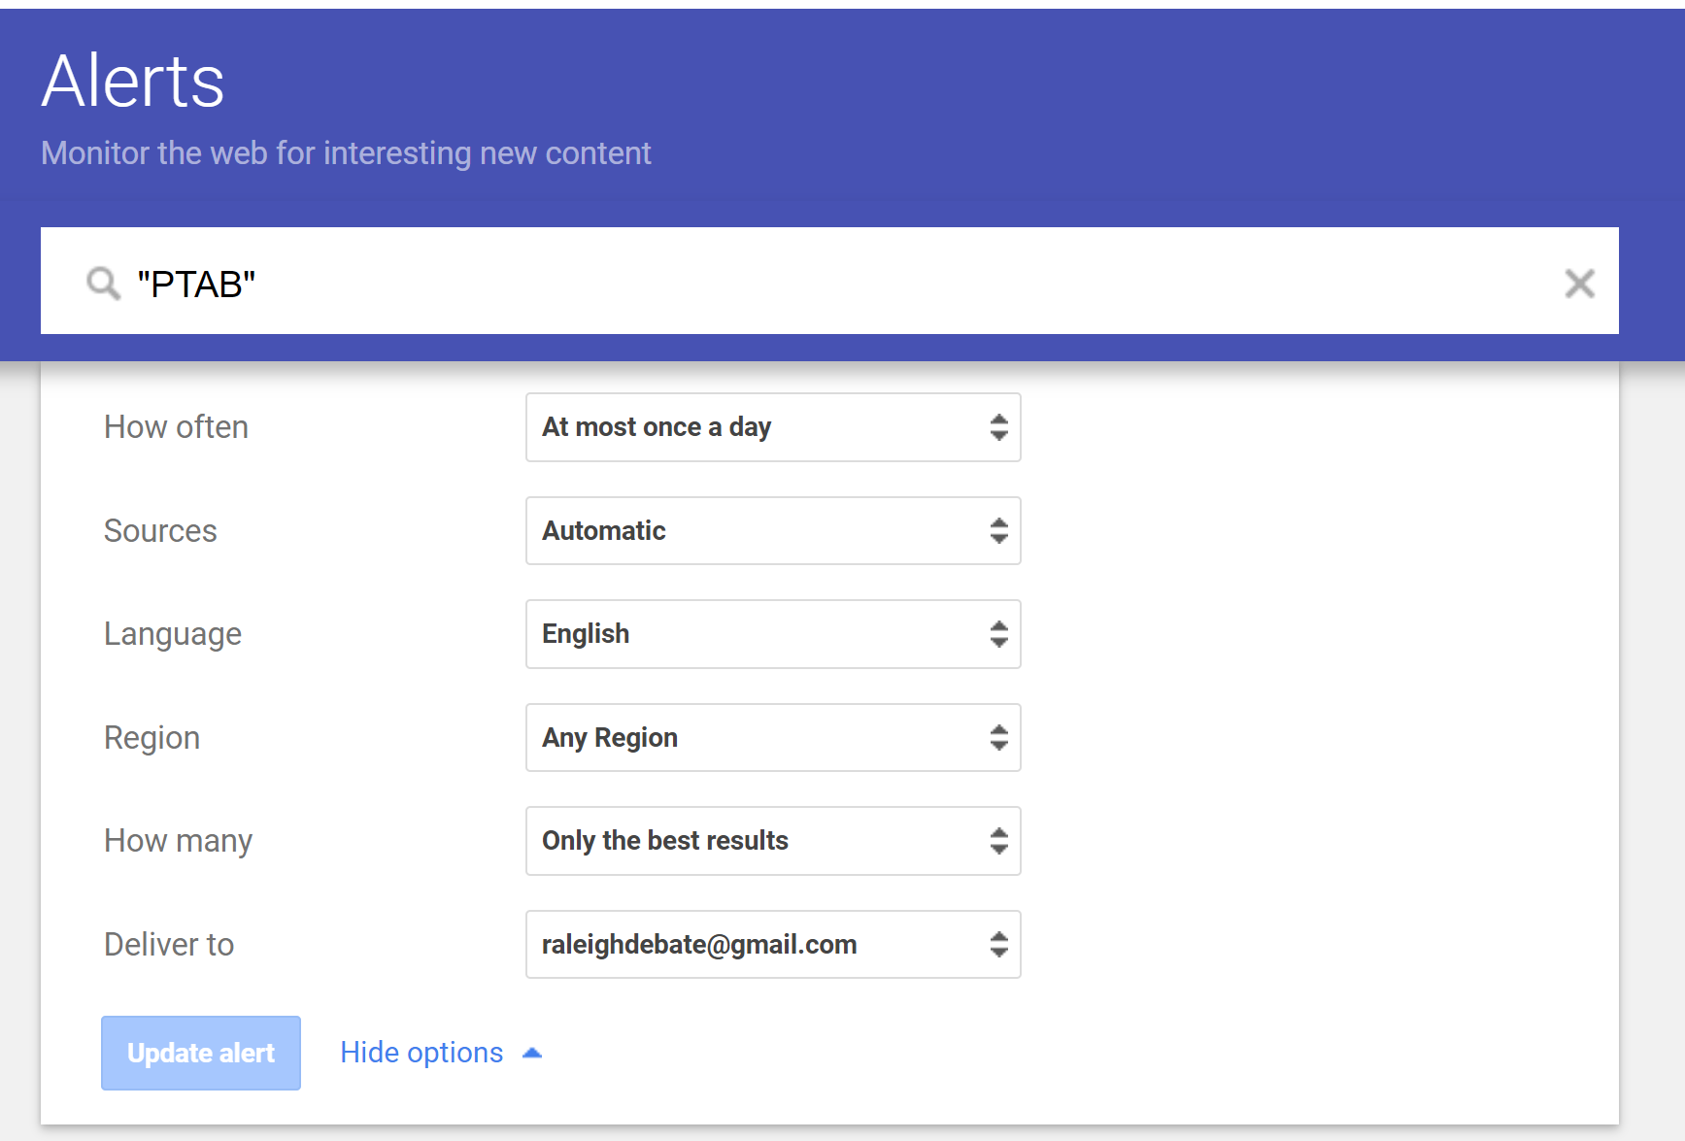
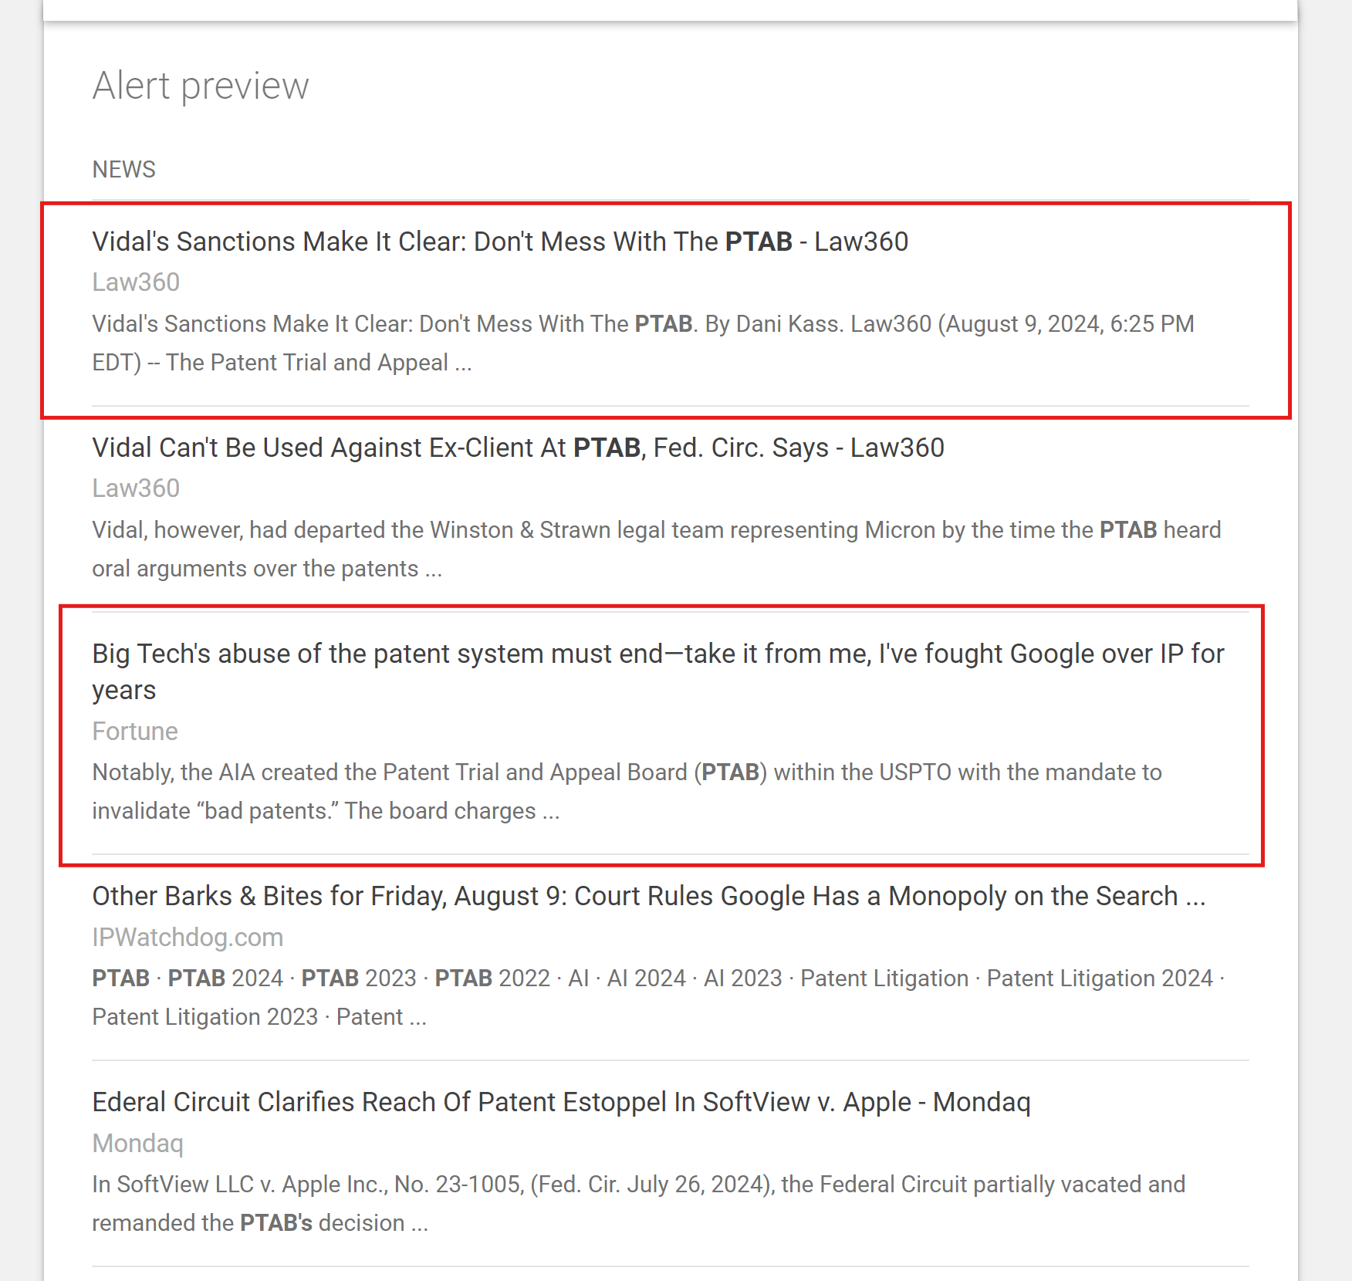
Passive Research – Google Alerts

Slide 16
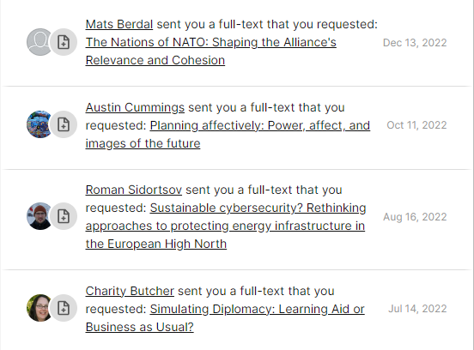
Type 1: Passive Research
Why is Research Gate so great?
Follow authors/topics
Request full-texts
Citation jumping
Why do we use passive research?
How do I passively research?
Google Alerts
Research Gate

Slide 17
Type 1: Passive Research
Why is Research Gate so great?
Follow authors/topics
Request full-texts
Citation jumping
Why do we use passive research?
How do I passively research?
Google Alerts
Research Gate
Really Simple Syndication Feeds
Inoreader
Feedly

Slide 18
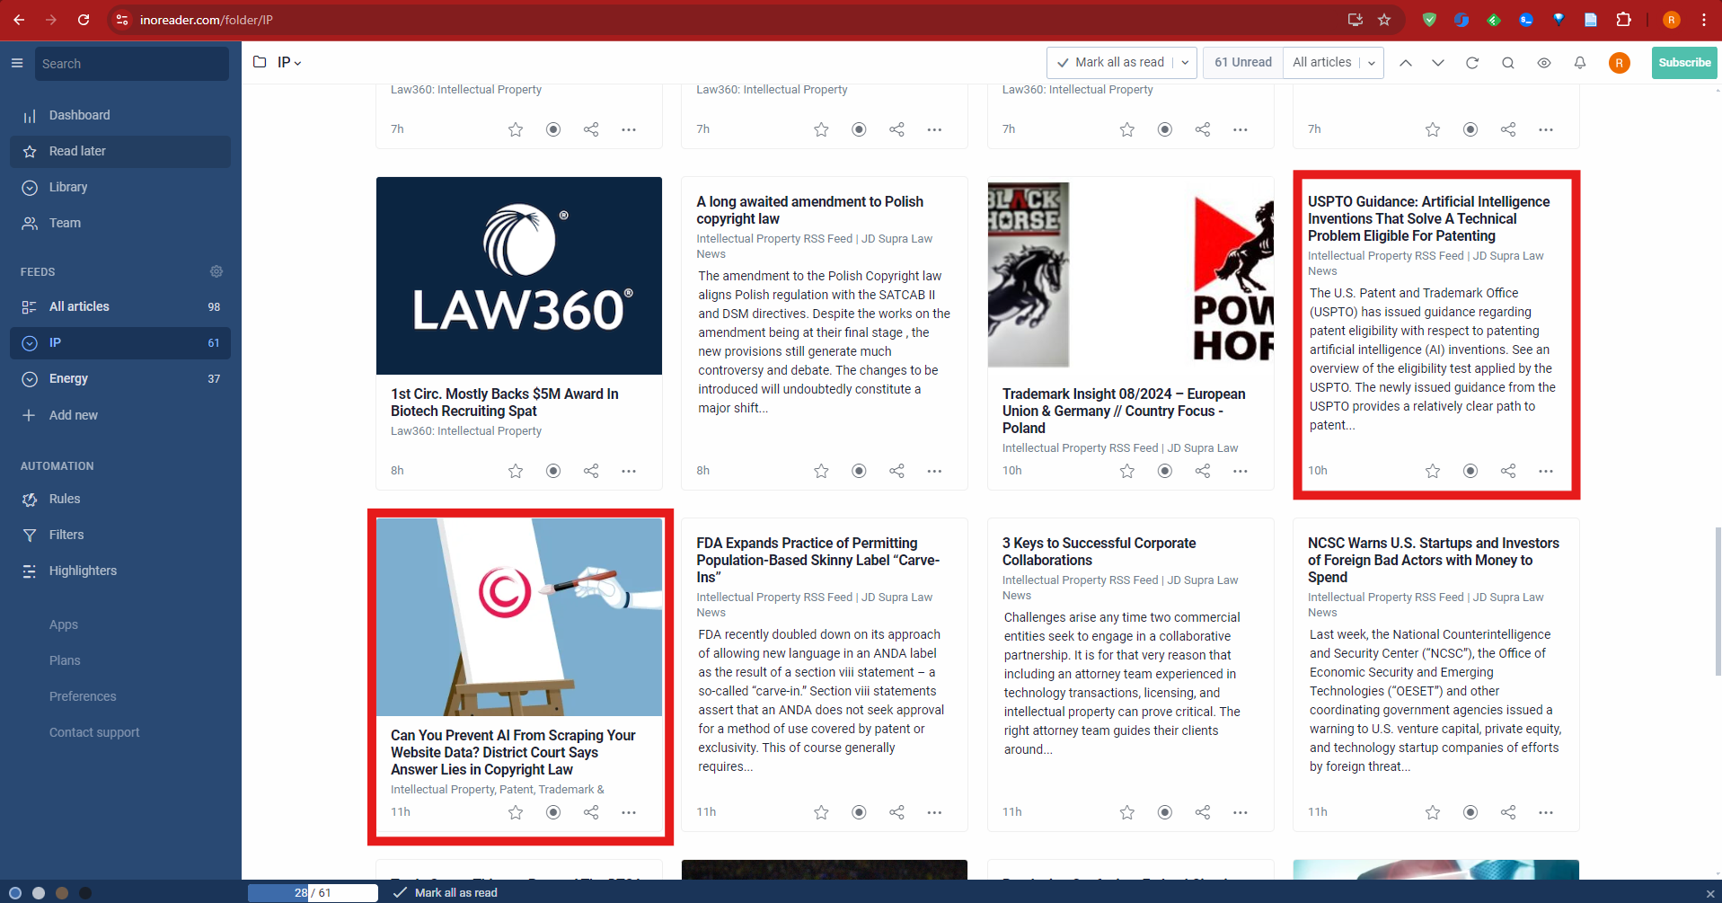
Passive Research – Inoreader

Slide 19
Type 1: Passive Research
Why is Research Gate so great?
Follow authors/topics
Request full-texts
Citation jumping
Why do we use passive research?
How do I passively research?
Google Alerts
Research Gate
Really Simple Syndication Feeds
Inoreader
Feedly
Email Newsletters
IAM – IP blog for business executives
Substacks – (Noah Smith, Yglesias, etc.)
Foreign Policy, Foreign Affairs

Slide 20
Passive Research - IAM

Slide 21
Type 2: Active Research – Core Tools
Google | Best system. Only downside is that it treats each tab as its own instance of the program, so it’s very resource intensive. Solution: The Great Suspender (don’t download the malware versions though!)
Ad Blockers | AdGuard AdBlocker, Malware Bytes, and uBlock Origin Lite
Hyperlink Savers | OneTab, Session Buddy, Zotero
Citation Creators | CiteCreator
DOP Finders | Finitimus, rip carbondate.cs.odu.edu ☹

Slide 22
Google Search Tricks
Quotes: search exact phrases
Boolean Operators:
Command | Description | Example
AND | Requires both phrases | “shop safe act” AND “money laundering”
OR | Requires either phrases | “marijuana” OR “cannabis”
AROUND(x) | Limits words between 2 phrases | “protection” AROUND(5) “definition”
- | Excludes these phrases | “patent thickets” -pharma -drugs
~ | Requires synonyms of a phrase | “protection” AROUND(5) ~definition
Site: | Results must be from specific site | “patents” site:foreignpolicy.com
* | Substitutes for any word | “intellectual property * protection”

Slide 23
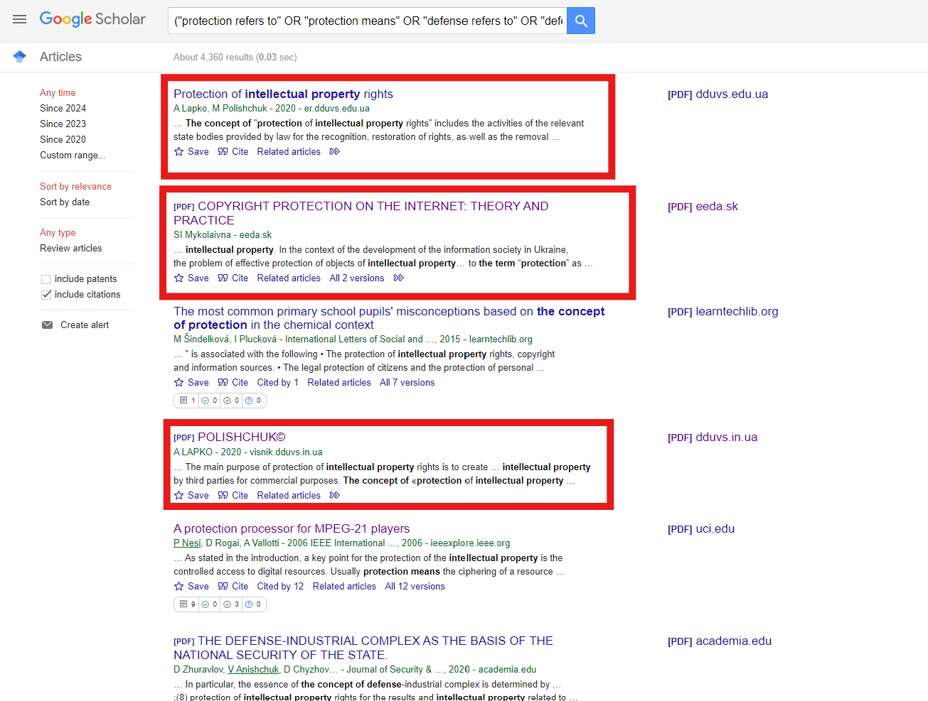
Google Search Tricks - Example
("protection refers to" OR "protection means" OR "defense refers to" OR "defense means" OR "the term defense" OR "The term protection" OR "The word defense" OR "The word protection" OR "The concept of protection" OR "the concept of defense") AROUND(10) ("intellectual property" OR "copyright" OR "patent" OR "trademark")

Slide 24
Where do I start?
01. Survey
Having a base-level understanding of the controversy you are researching will make your reading much more efficicient; it allows you to skim over “intro” portions of articles.

Slide 25
Where do I start?
01. Survey
02. Note “terms of art"
Having a base-level understanding of the controversy you are researching will make your reading much more efficicient; it allows you to skim over “intro” portions of articles.
The best search results come when you are using the correct terminology in your searches. The IP topic is filled with terms of art, so make sure to use them in your searches.

Slide 26
Where do I start?
01. Survey
02. Note “terms of art"
Having a base-level understanding of the controversy you are researching will make your reading much more efficicient; it allows you to skim over “intro” portions of articles.
The best search results come when you are using the correct terminology in your searches. The IP topic is filled with terms of art, so make sure to use them in your searches.
03. Find the “right side”
Researching will be much easier if you the lit agrees with you. If it doesn’t agree with you, it is very helpful to know what you are up against!

Slide 27
Where do I start?
01. Survey
02. Note “terms of art"
Having a base-level understanding of the controversy you are researching will make your reading much more efficicient; it allows you to skim over “intro” portions of articles.
The best search results come when you are using the correct terminology in your searches. The IP topic is filled with terms of art, so make sure to use them in your searches.
03. Find the “right side”
04. Follow the lit
Researching will be much easier if you the lit agrees with you. If it doesn’t agree with you, it is very helpful to know what you are up against!
Forcing arguments is inefficient and unstrategic (but sometimes OK!). If you are hell-bent on an argument and the lit is not giving you anything, try a new angle.

Slide 28
Three tips for research
01. Drill, baby, drill!
Chasing down cards cite by cite, search result by result will ensure you miss nothing. Writing big, robust files requires you to put in a good deal of effort and time.

Slide 29
Three tips for research
01. Drill, baby, drill!
02. Inverted Research Pyramid
Chasing down cards cite by cite, search result by result will ensure you miss nothing. Writing big, robust files requires you to put in a good deal of effort and time.
Your research should begin broad, reading everything you find on a particular topic. Once you have the “bones” of your file, you should then begin to fill the holes in your file.

Slide 30
Three tips for research
01. Drill, baby, drill!
02. Inverted Research Pyramid
03. Research both sides
Chasing down cards cite by cite, search result by result will ensure you miss nothing. Writing big, robust files requires you to put in a good deal of effort and time.
Your research should begin broad, reading everything you find on a particular topic. Once you have the “bones” of your file, you should then begin to fill the holes in your file.
The best way to ensure you answer every potential answer to your file is to research the other side. Doing so will also benefit your 2Ns/2As!

Slide 31
Where do I find cards?
Google | Should almost always be your first search.
Google Scholar | Better for K cards, journals, etc. (Note: “cited by” function is cracked)
Lexis, HeinOnline | Better for law reviews + T interps, catches things Google can’t access
CRS | Great for background reading
ResearchGate | Usually not a great first option, sometimes useful
Takeaway: Google is your go-to

Slide 32
Tips for evaluating cards
Conclusive
Comparative
You typically only need cards that make an argument. Avoiding articles that are merely a summary of the controversy is important for cutting efficiency.
Some articles perform the role of the judge for them, by comparing Policy A to Policy B and offering an argument as to why one is better than the other.
Qualifications
Novelty
You should steer clear of cutting cards from undergraduates, suspicious blogs, etc. That being said, this might not matter much in high school debate. ☹
Finding novel pieces of evidence that offer different warrants are really important for big files. 20 cards making the exact same argument citing the same study pale in comparison to three cards with varied warrants.

Slide 33
Bypassing Paywalls
Legal methods:
Email authors if you can’t get past paywalls! (can also request on ResearchGate)
Send articles to #article-requests in the slack!
“Innovative” methods you should avoid:
Anna’s Archive – combo of LibGen and SciHub
Unpaywall – automatically eliminates paywalls, really dangerous
Archive.ph – has most webpages, avoid it at all costs!
Wayback Machine – sometimes has webpages

Slide 34
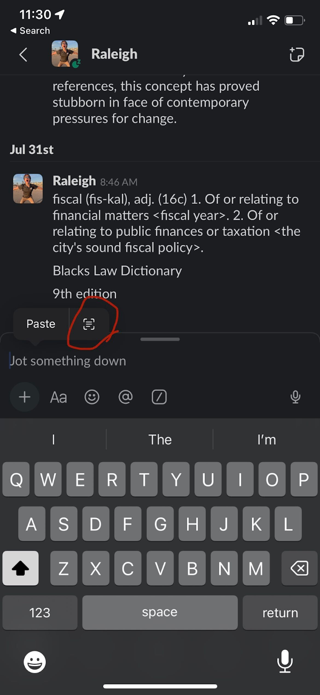
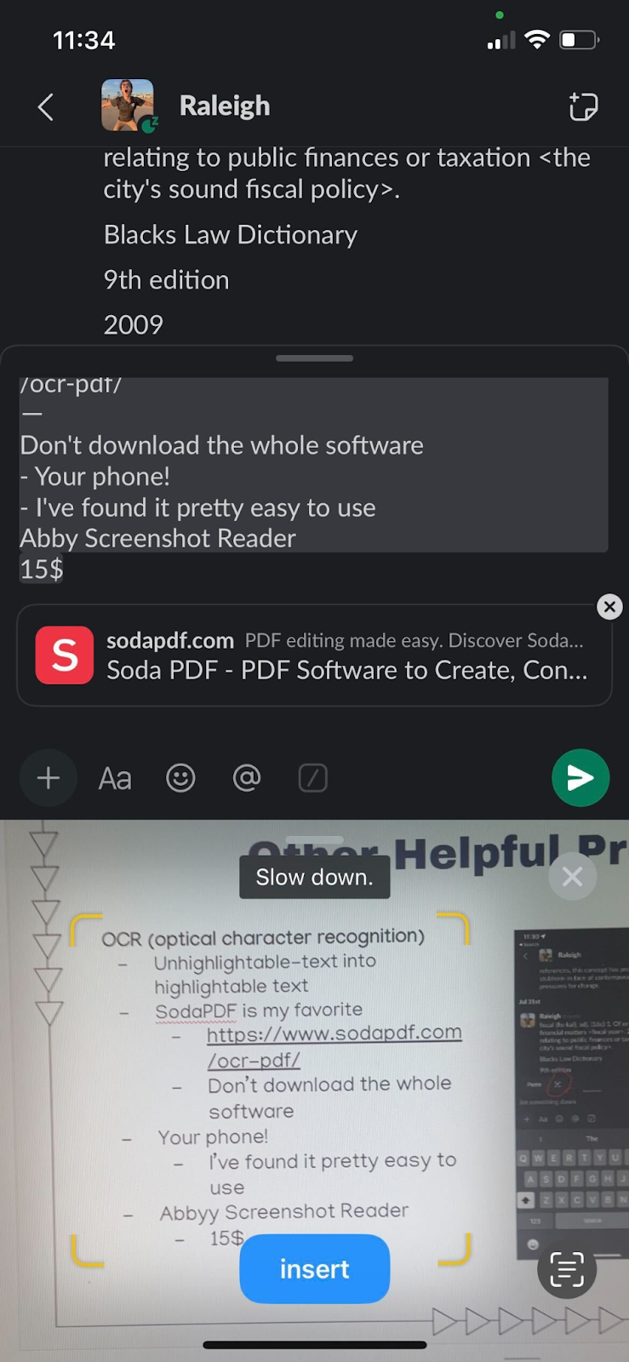
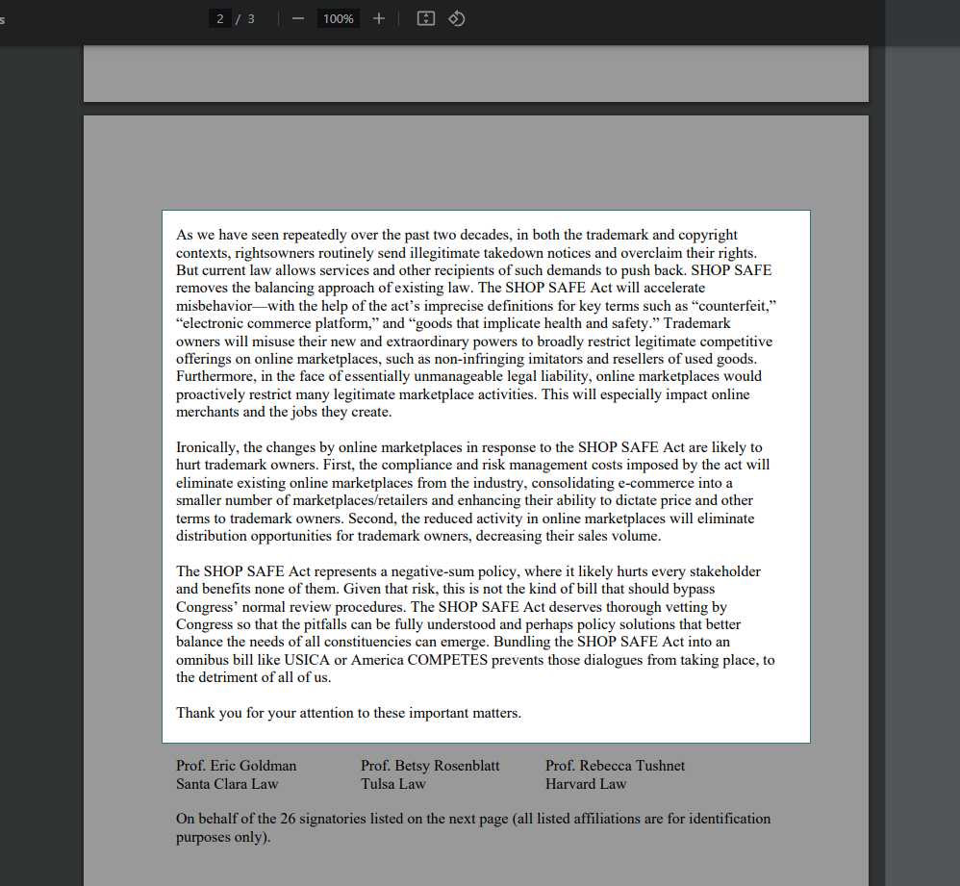
Other Helpful Programs (Windows)
PowerToys
FancyZones – makes it easy to create window layouts/split screen
Text Extractor – my new favorite OCR software (Win + Shift + T)
Other OCR options
Slack – has a decent built in OCR system, can use phone to scan
SodaPDF – reliable, another free option

Slide 35
Other Helpful Programs (cont.)
Ebook Reader 64Bit
Lets you read EPubs!
Can also convert PDFs to Epubs

Slide 36
Other Helpful Programs (cont.)
Ebook Reader 64Bit
Lets you read EPubs!
Can also convert PDFs to Epubs
Start All Back
Reverts to Windows 10 layout, keeps rest of 11
Asks for you to pay after a while but you can just click x lol

Slide 37
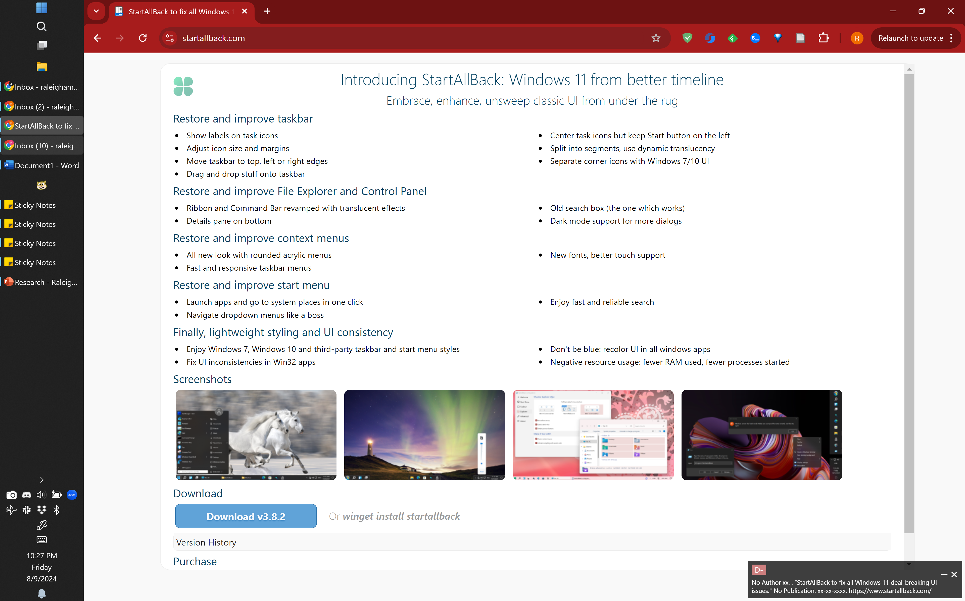
Other Helpful Programs (cont.)

Slide 38
Other Helpful Programs (cont.)
Ebook Reader 64Bit
Lets you read EPubs!
Can also convert PDFs to Epubs
Start All Back
Reverts to Windows 10 layout, keeps rest of 11
Asks for you to pay after a while but you can just click x lol
DocFetcher
Incredibly amazingly stupendously useful
Indexes your entire Dropbox, searching files has never been this easy!

Slide 39
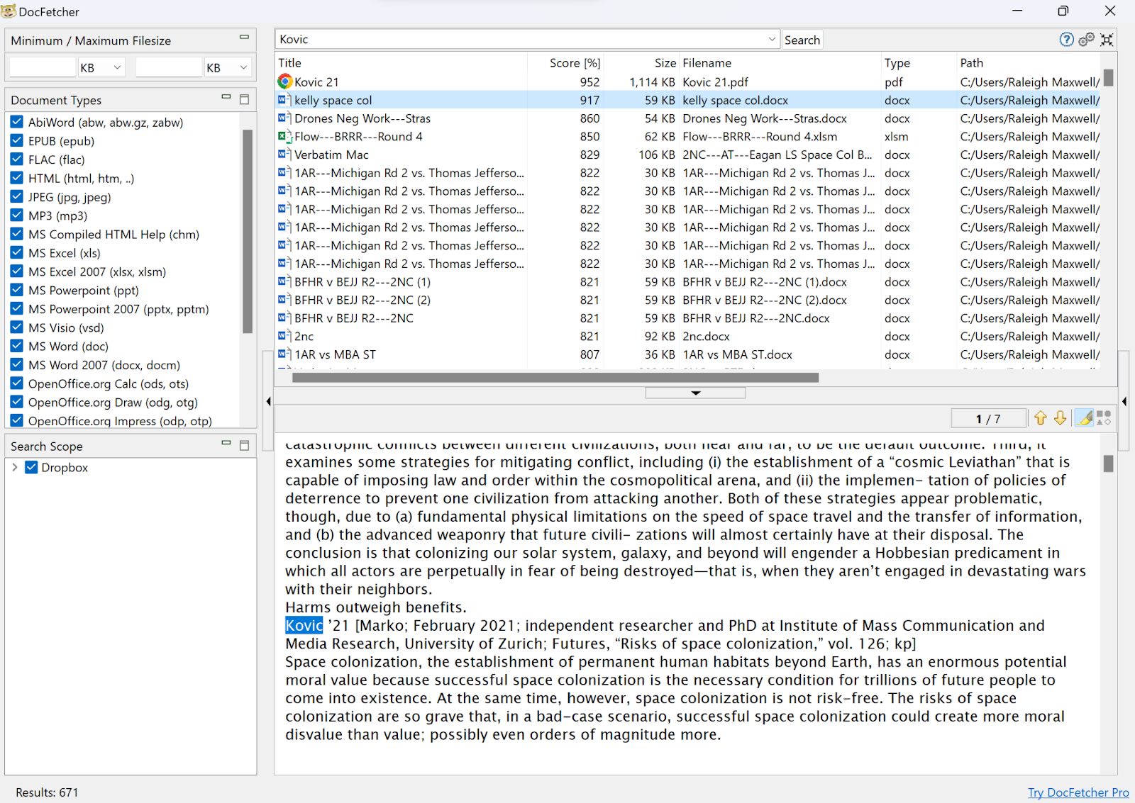
Other Helpful Programs (cont.)

Slide 40
02
Card-Cutting

Slide 41
Choose Your Weapon
vs
The Mouse
The Keyboard
Pros:
Easier to learn
What to look for:
Programmable buttons
Battery life
Bluetooth – helpful, not necessary
Suggestions:
Redragon (windows only)
Razer Naga
Pros
Much faster
It feels like a video game
Shift + Click (left/right) - select by character
Shift + Ctrl + Click - select by word
You can decide which keys to use for underline + emphasize

Slide 42
My Case for the Keyboard

Slide 43
The Process
01. Cite and Copy Text
02. Box and Underline
Clear! Clear! Clear! Maintain paragraph integrity.
Don’t over-emphasize or over-underline, but still get the warrants out of the article.
03. Tag
04. Highlight
Highlight the message of the card. Tagging is an art of balance between brevity and depth. Prioritize comparision in your tags.
Highlight full sentences! Avoid repetition – don’t highlight the same warrant twice.

Slide 44
Citation Creation – Non-Scholarly Work
First Last YY: no MI, only one author, bold others
Quals: should not be complete sentences, but appositives, i.e. do not copy from site
Initials: don’t make them ugly
Title
Date: Use slashes
URL: for non-scholarly work, use URL. If it’s too long that it makes the card ugly, use TinyURL or see if you can shorten it. (Note: Unpaywall can often make URLs unnecessarily long)

Slide 45
Citation Creation – Scholarly Work
Volume(Iss/No.)
DOI: do not use the URL, use the DOI
Pages: of the article, not where the card is from
Journal: should be italicized

Slide 46
03
Organizing Files

Slide 47
Tips for File Organization
01. Assemble
02. Finalize
03. Fix and Fill
Have an organizational system
Use placeholder tags
Highlight deliberately
Organize and assess at the end of sessions
Decide the 1NC/1AC
Choose supporting ev based on those decisions
Finalize tags
Standardize tags
Fill every hole
Preempt answers
Preempt answers to answers
Don’t avoid writing blocks you don’t want to write

Slide 48
Questions?

